Slide 1
Testing of Google
By cqi
Date

Slide 2
content
Brief introduction about testing of google
What is quality
Roles related with quality
Google‘s Organizational Structure
Versions
Software engineer in test (SET )
What is SET
The life of SET
Types of Tests
Test engineer (TE )
The life of TE
Make test plan with ACC
Risk analysis
Fatal Flaws in Google’s Process
What can we learn from the google testing

Slide 3
What is quality
Quality is a development issue, not a testing issue
Quality is more an act of prevention than it is detection
The marriage of development and testing is where quality is achieved

Slide 4
Roles related with quality
software engineer (SWE)
write functional code
write a lot of test code
software engineer in test (SET)
focus on testability and general test infrastructure
review designs, concerned with increasing quality and test coverage
test engineer (TE)
product experts, quality advisers, and analyzers of risk
on behalf of the user

Slide 5
Google‘s Organizational Structure
QA department
Loan to different product
chrome
map
gmail
search
blogger
…
Product line

Slide 6
Google‘s Organizational Structure
1. Test exists in a separate and horizontal Focus Area called Engineering Productivity
2. If a development team wants us to take any shortcuts related to testing, these must be negotiated in advance and we can always decide to say no.
The on-loan status of testers also facilitates movement of SETs and TEs from project to project, which not only keeps them fresh and engaged, but also ensures that good ideas move rapidly around the company

Slide 7
Versions in Google
Canary Channel
Nightly builds
Dev Channel
Debug build
Test Channel
Internal test
Beta Channel or Release Channel
Build the core of a product and release it
Get feedback and iterate

Slide 8
What is SET
Testability is another feature of the application own by SET
creating vs breaking = feature code vs test code
Not SWE or SE
Strong enough programmers to write feature code, strong enough testers to test about anything, and able to manage their own work and tools

Slide 9
The life of SET
Requirement
SET need broadest view of the product
Output
Isolate the interfaces，create mocks and fakes
build a lightweight automation framework that allows the mocked system to be built and executed，SWE can run the test automation before they check in the codes.
What to do
Reviewing design documents
Completeness
Correctness
Consistency
Design
Interfaces and protocols
Testability
Code review

Slide 10
Types of Tests
Small tests ： Unit testing（SWE）
Medium tests ： Integration testing（SET）
Large tests ：System testing
Optimal ratio(Small/Medium/Large) : 70/20/10

Slide 11
The life of TEs
Test planning and risk analysis
Review specs, designs, code, and existing tests
Exploratory testing
User scenarios
Test case creation
Executing test cases
Crowd sourcing
Usage metrics
User feedback
TEs often have little to do early in the development cycle
Starting at the beginning is not suitable in Google

Slide 12
Make test plan with ACC(Attribute Component Capability )
Why
Test plans are the first testing artifact created and the first one to die of neglect.
What
Attribute：the adjectives of the system
Component：the core components and chunks of code that make the software what it is.
Capability：the actions the system performs at the command of the user
Attributes across the x axis and components across the y axis, then we link capabilities back to attributes and components（tool: Google Test Analytics ，GTA）
Example
Add/remove items from the shopping cart. This is a capability of the Cart component when trying to meet the intuitive UI attribute.

Slide 13
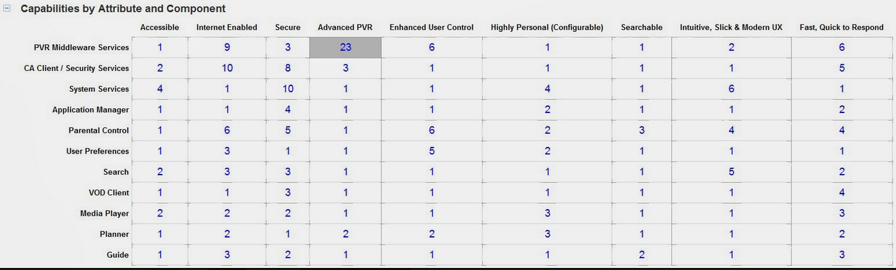
ACC example

Slide 14
Risk analysis
Frequency of failure:
rarely
seldom
occasionally
often
Impact:
minimal
some
maximal

Slide 15
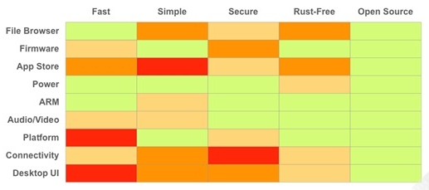
Risk analysis example
It is Capabilities heap map for Chrome OS .The green area is low-risk, red area is high-risk, pink and orange area are between low and high. Tester will arrange the priority according to this heap map, apply limited resource into the area which need test most.

Slide 16
Fatal Flaws in Google’s Process
Testers have become a crutch for developers. The less we make them think about testing and the easier we make testing, the less testing they will do
Testers identify with their role and not their product
Testers often worship test artifacts over the software itself

Slide 17
What can we learn from the google testing
As mentioned in early slides, testers in google is on-loan, which ensures that good ideas move rapidly around the company, this mode is hard in our company, since our product is too complicated to take over in s short time, but rotation of regression is a good choice for us, different regression for one product are related, while different person have different ideas in regression, rotation will enlarge our view for product and spread good ideas in the team.
I’m glad that OPC team have put it in practice.

Slide 18
What can we learn from the google testing
ACC and Heap map of risks can be used in our feature testing.
Requirement of a new feature may change during developing, test plan always need update, ACC can help make a brief test plan.
For Heap map of risks, we can use it to arrange our testing priority, at least we can cover the area with biggest risks when resource is limited

Slide 19
What can we learn from the google testing
Quality is a development issue, not a testing issue
I think this concept should let SWE understand deeply, testers are not their crutch ,SWE should think more about testing when their write codes.

Slide 20
What can we learn from the google testing
Google have 20% time policy: google encouraged employees to spend about 20 percent of their time experimenting with their own ideas.
if new ideas are always encouraged by company to be put in practice , I think it is great, it will form a good atmosphere for innovation, maybe some good products come out some day like many of the early prototypes that we have seen come from Google 20 percent efforts

